Slide 1


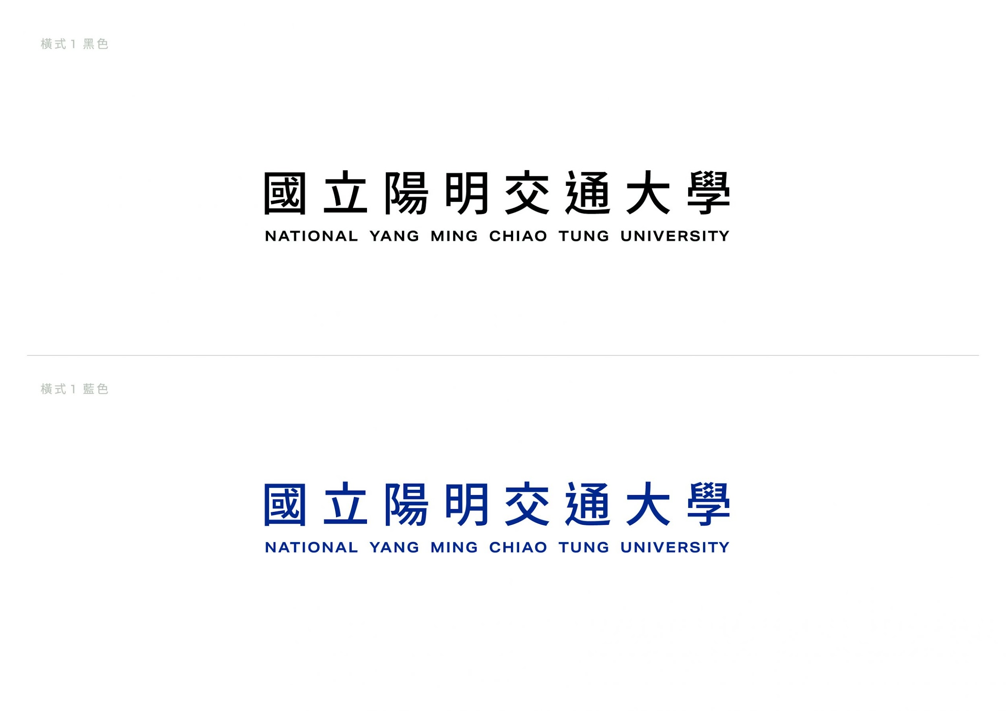
Lecture 5 : Radio Maps for 6G
Class GitHub: https://github.com/NYCU-ICCLab/sionna_introduction
NVIDIA website: https://developer.nvidia.com/sionna
Sionna official tutorial: https://nvlabs.github.io/sionna/index.html
Sionna GitHub: https://github.com/NVlabs/sionna

Slide 2
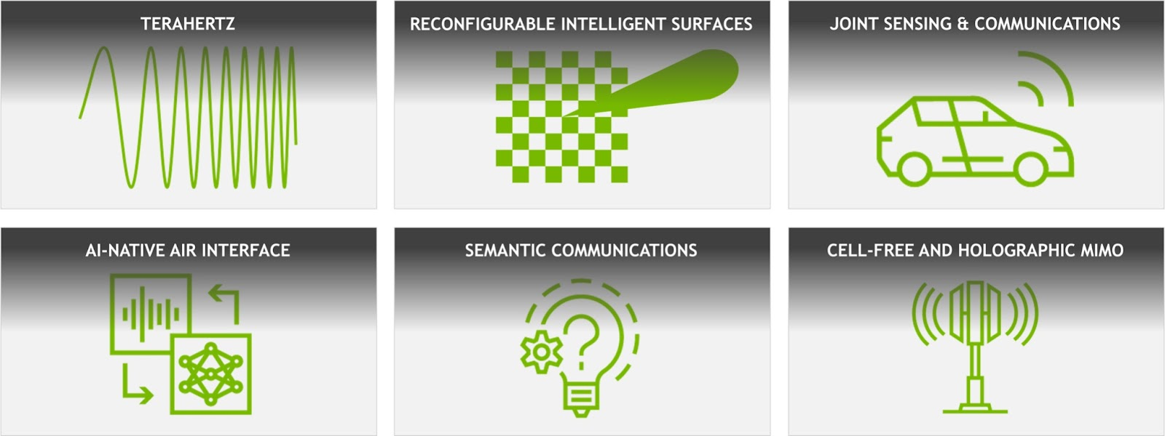
Physical-Layer tooling, isn’t Matlab enough?
Need for 6G-ready tools: As the industry moves towards 6G, researchers require simulation frameworks capable of handling unprecedented modeling accuracy and scale.
Integration of AI/ML: There's a growing need for link-level simulators with native machine learning integration and automatic gradient computation.
Environment-specific simulations: Many 6G technologies demand simulations of specific environments with spatially consistent correspondence between physical location, wireless channel impulse response, and visual input.
Computational efficiency: The complexity of modern wireless systems necessitates GPU-accelerated simulations to enable interactive exploration and rapid prototyping
courtesy : NVIDIA Sionna

Slide 3
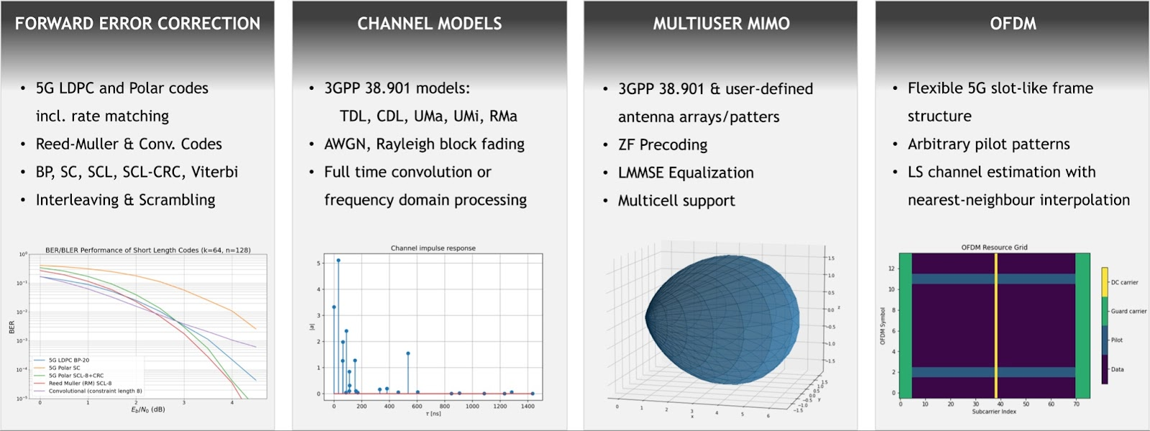
Importance of PHY Layer simulation
Open-source and accessible: As researcher and student, the needs for an accessible tools becomes important → As an open-source library, Sionna democratizes 6G research, allowing researchers to focus on impactful and reproducible work.
Differentiability: Sionna's differentiable architecture enables gradient-based optimization and seamless integration of neural networks into communication systems.
courtesy : Sionna Documentation

Slide 4
Importance of PHY Layer simulation
Modular design: The framework's modular and extensible nature facilitates rapid prototyping of complex communication system architectures.
GPU acceleration: Sionna leverages NVIDIA GPUs for orders-of-magnitude faster simulations, enabling interactive exploration of complex systems.
Integrated research platform: It combines channel-, link-, and system-level simulation capabilities with machine learning support
courtesy : Sionna Documentation

Slide 5
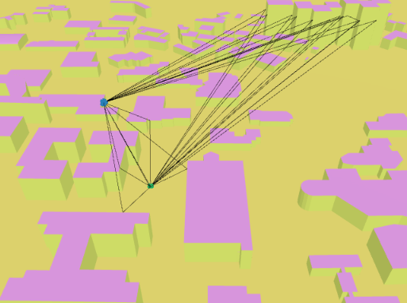
What is Sionna?
Open-source Wireless Communication Simulation Framework
Built upon TensorFlow, designed for developing, analyzing, and validating wireless communication algorithms
Particularly suited for research and development in modern wireless standards such as 5G/6G
Video : https://youtu.be/cYUNE4i4Q4E

Slide 6
Simulation Accuracy
Digital Twin fidelity: Research comparing Sionna to Wireless InSite (WI) and real-world data from the FLASH dataset shows that Sionna's accuracy generally improves as the fidelity of the digital twin increases.
LOS vs NLOS scenarios: Sionna's performance varies between Line-of-Sight (LOS) and Non-Line-of-Sight (NLOS) scenarios, with accuracy trends slightly outperforming WI in certain parameters.
Beam selection accuracy: When evaluating the top 10 beams, Sionna's accuracy in matching real-world data ranges from 54% to 82% depending on the simulation fidelity.
Comparison metrics: Various metrics such as Magnitude Difference (MD), Cosine Similarity (CS), and Normalized Discounted Cumulative Gain (NDCG) show high similarity between Sionna and other simulators, particularly for higher-fidelity simulations.
and many other ongoing development: As an actively developed tool, Sionna's accuracy is likely to improve over time, with future extensions such as integrated ray tracing promising even more precise simulations

Slide 7
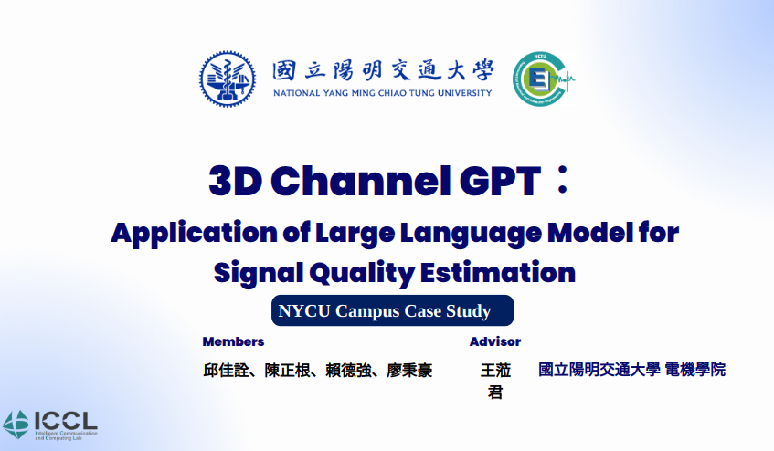
Application Scenario Example
For first two : Digital Twin fidelity and LOS vs NLOS scenarios we could show some applications scenario

Slide 8






Background & Motivation
UAV(Unmanned aerial vehicle) as aerial base station
3D spatial air-to-ground communication
Current limitation：
Traditional communication model is for simple environment
Mobility and obstacle in UAV communication scenario
The estimation of signal quality becomes more complex and challenging
Objective : To understand the signal quality for users in different areas within an air-to-ground communication system
Signal Quality Estimation Framework Based on Large Language Model
Fine-tuning the Large Language Model (LLM)
Enabling users to understand the communication environment through text-based queries and answers
Applying and validating this framework in NYCU campus
‹#›
Notes:
首先要先跟大家說明，我們實驗室的研究主題是以無線通訊為主，目前正在針對無人機通訊的主題進行研究
我們的情境將會以無人機作為空中基地台，針對3D立體空間的空對地通訊模式進行探討
在目前的大多數無人機通訊的研究中大多存在著一些問題，像是傳統的通訊模型主要是針對簡單環境進行設計，但三維通訊中無人機的移動性以及障礙物都使得訊號品質的預估更加複雜且具有挑戰性
為了解決這個問題，我們想要透過AI來協助我們進行研究。
我們的目標是使用AI來理解空對地的通訊環境，並能夠告訴我們用戶在不同位置的訊號品質，針對這個問題，我們提出了一個基於大型語言模型的訊號品質預估框架。
簡單來說就是我們會使用現有的大型語言模型去做Transfer learning，讓使用者能夠以文字問答的形式去了解當前的通訊環境，並使用陽明交通大學光復校區作為應用場景，來驗證這個框架的可行性。
要強調為什麼使用LLM 讓大家都可以簡單的知道專家才能幫你取得的知識

Slide 9
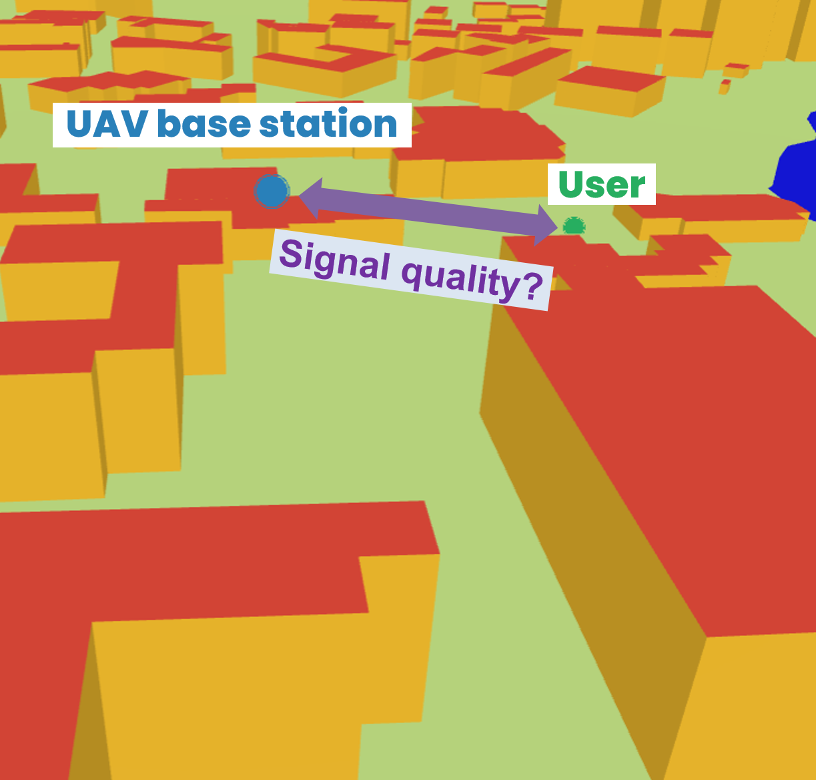

What we do? – 3D Channel GPT
Input the 3D spatial position information of base stations and ground users into the AI model
The model outputs the estimated signal quality results.
generate
input
output
3D Channel GPT
……, what is the received power level?
Very strong
We create 3D Channel GPT, which provides user-friendly Q&A dialogue service to assess signal quality in site-specific 3D air-to-ground communication by extending DeepMentor solution.
‹#›
Notes:
這邊先簡單說明一下什麼是3D Channel GPT
3D Channel GPT是我們使用滿拓的solution所建立的語言模型。假設我們已經有一個地理環境的資訊，我們可以透過向模型說明基地台的擺放位置以及地面用戶位置，
讓模型回答我們在這個位置的訊號品質會是好還是不好

Slide 10
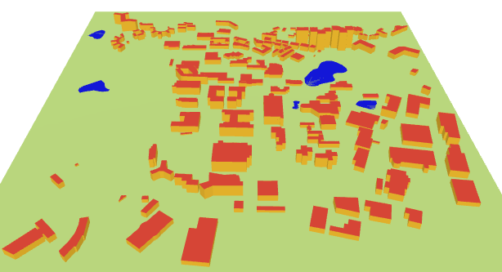


3D Channel GPT Framework
Communication Environment
Model training
Generating
Dataset
NYCU Campus
LLaMA model
(Llama-2-7b-hf)
Map information
Tx&Rx position, received power…
Generating communication dataset
Data preprocessing Converting into Q&A format
Fine-tuning
Communication parameters
Q: ……, what is the received power level?
A: very strong
3D Channel GPT
‹#›
Notes:
接下來是我們的架構，架構主要分成三個部分，
首先是通訊環境的配置，因為我們要模擬的是交大環境的通訊，因此交大的地圖資訊還有通訊的參數都是必要的
在有了地圖資訊以及通訊參數後，我們可以生成訓練用的通訊資料集
資料集的內容包含了訊號的發射端以及接收端，也就是基地台和地面用戶的位置還有訊號強度等等的資訊
而為了讓語言模型可以更好的去理解我們的資料，我們需要把原始的通訊資料轉換成Ｑ＆Ａ問答的形式，就像上面問題的部分寫的what is the power level，而模型可以回答very strong
最後則是使用滿拓和群聯提供的大型語言模型去對通訊資料集做Fine-tuning來生成我們的3D channel GPT

Slide 11



3D Channel GPT : Workflows
Environment and dataset construction
Model training
Model validation
Radio Map Simulation
Dataset Collection
Dataset Preprocess
LLaMA
3D Channel GPT
Case 1
Case 2
Conclusions
‹#›
Notes:
接下來我會針對如何產生我們的通訊資料集、以及如何訓練模型來做說明
並對我們的兩個use case進行個別的討論

Slide 12


Environment and dataset construction
‹#›
Notes:
首先是我們通訊環境以及資料集建置的說明

Slide 13
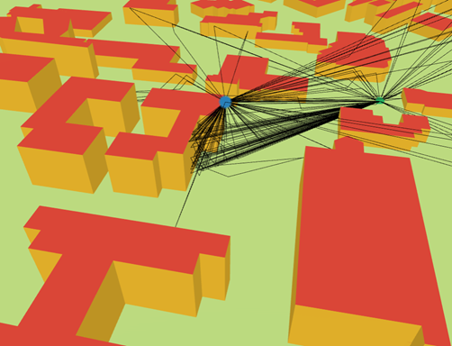
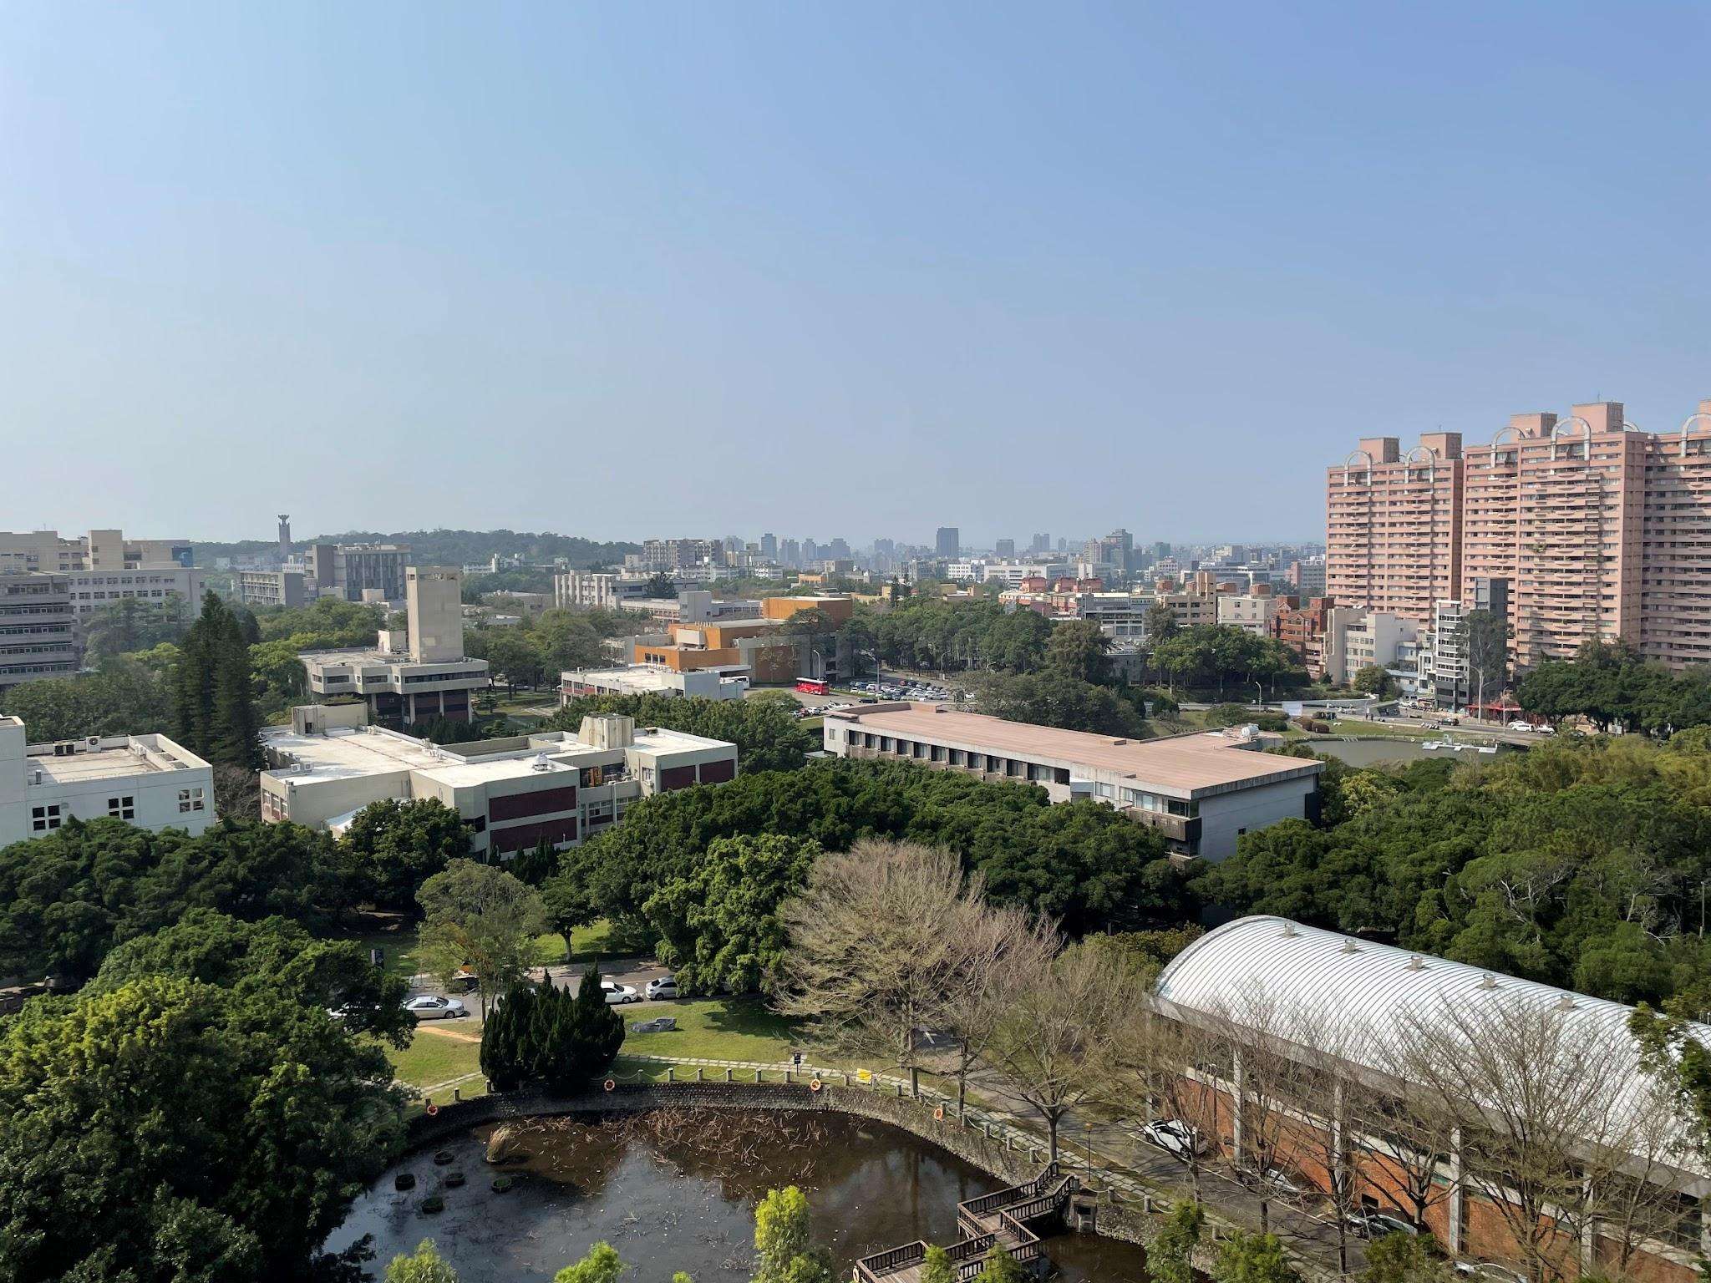
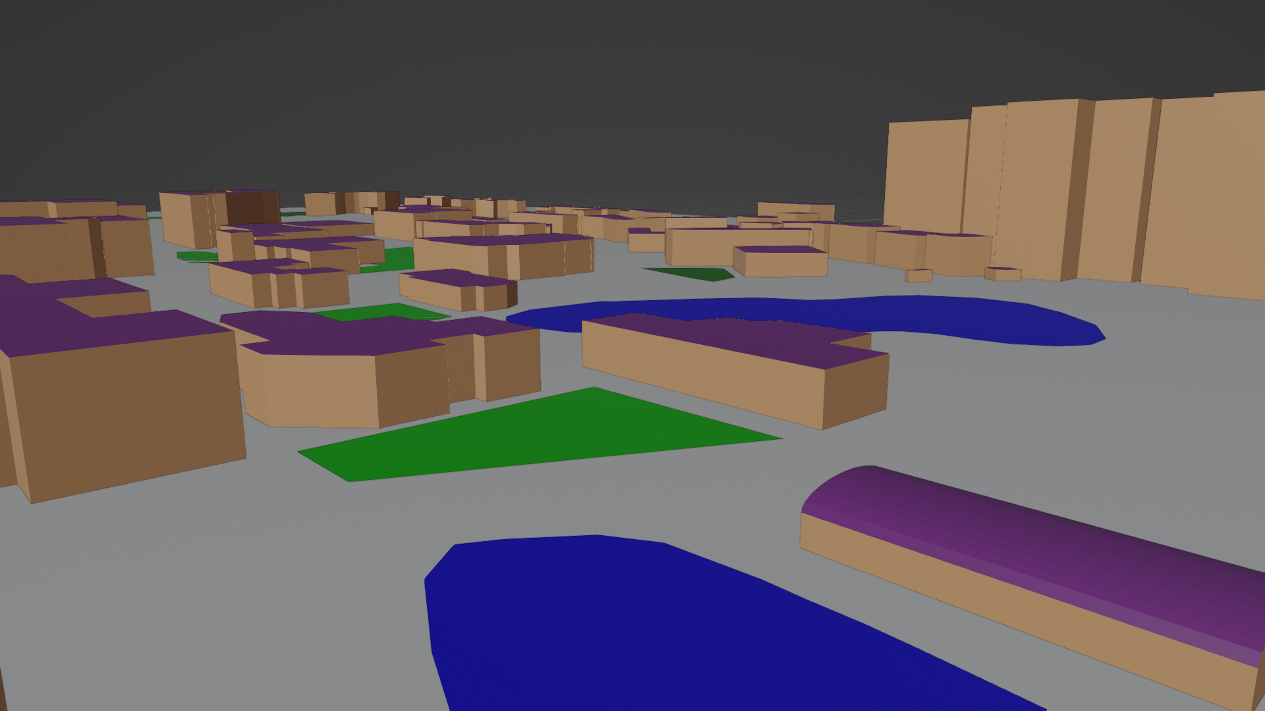
The First Open Data Generated Radio Map@ NYCU Campus
 | Traditional Method | Our Method
Map information | Required On-Site Measurements | Open-Source Information
Ray tracing communication simulation | $$$$ | Free (Open-Source)
AI support | Low | High
✅
✅
✅
Our team has developed a simulated communication environment for NYCU campus by integrating open-source map data and employing Ray tracing technology.
工程四館
工程三館
圖書館
工程五館
▲ Simulation of the Communication Environment of NYCU Campus using Ray Tracing
▲ Comparison between NYCU Real World and Rendered Scenes
‹#›
Notes:
為了產生訓練用的資料集，我們團隊採用了開源的地圖資訊結合通訊的ray tracin技術來生成通訊資料。
大家可以先看到右下的圖片，左手邊是從這棟電資大樓的屋頂上能夠看到的風景，右邊的部分則是我們透過開源的地圖資訊把交大的環境用軟體成功渲染出來的樣子
最後我們把地圖和通訊軟體整合，使用Ray tracin的方式來模擬通訊。
左半邊這張圖就是我們使用Ray tracin模擬通訊的結果，那些線條就是代表傳播的路徑
我們的方案的優勢在於完全免費，在早期的做法中無論是地圖資訊以及Ray tracing 通訊模擬都是要花很多錢來做的，並不是大家都有經費可以購買這些東西
（據我們所知，我們應該是第一個用完全開源的資料建立交大通訊環境的團隊）

Slide 14
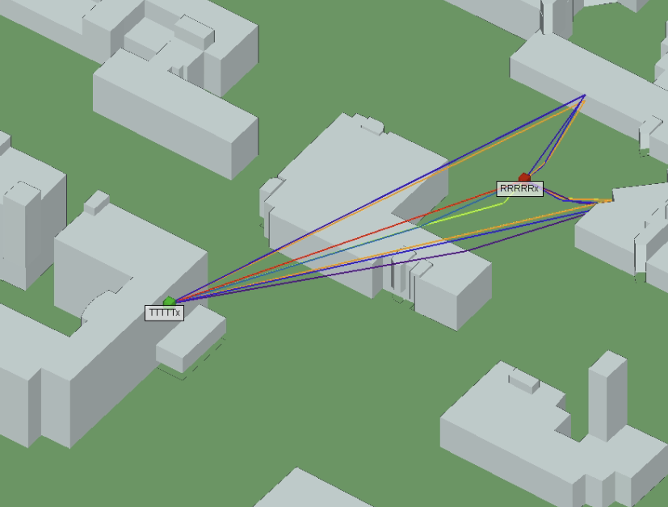
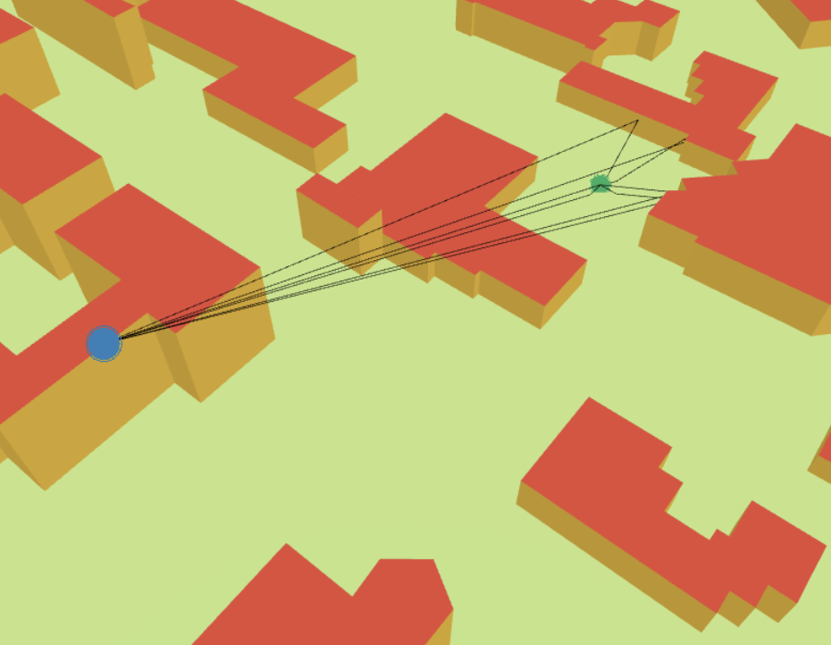
Comparison : Traditional Radio Map vs. Our Approach
Receiver
Receiver
Transmitter
Transmitter
▲ Simulation of Traditional Method
▲ Simulation from our Method
 | Traditional Method | Our Method
Path loss | 84.346 dB | 84.377 dB
Computing time | 50.506 s | 0.268 s
Similar Results
Faster Computing Time
‹#›
Notes:
除了經濟上的優勢外，我們的方案還有著更為顯著的優點
大家可以先看到左邊那張圖，左邊的圖是使用傳統的方案模擬交大的通訊
右邊則是我們的開源方案
兩張圖都是模擬同一個位置的通訊，從下面的表格可以看到在計算訊號衰減的任務中，傳統方案的計算結果和我們計算結果的數值非常接近
但我們計算的速度遠比傳統方案還要快，差距快要達到兩百倍
說明以前要花很多錢買地圖+模擬軟體
BEFORE VS AFTER
比較insite和sionna

Slide 15

Environment-Aware Radio Signal Map by Ray Tracing
Wireless communication parameter setting
Parameters | Description
UAV Position | (0, 0, 100)
Carrier Frequency | 2.65 GHz (4GLTE band 7)
User Position | Random
Record
User Location
Distance (UAV-User)
LoS / NLoS
Randomly Sample 10,000 Data Points
User’s Received Power
▲ Wireless Communications’ Simulation Parameters based on UAV and User Locations
‹#›
Notes:
接下來我來說明一下我們的通訊資料集是如何產生的
從剛才的介紹中可以知道我們是使用Ray tracing的方式來模擬通訊，而我們的資料集就是給定基地台的位置還有通訊參數
並隨機在3D的地圖上取樣一萬筆資料來做Ray tracing，當作用戶的通訊資料，在這裡面會紀錄基地台還有用戶位置等等的資訊

Slide 16
Classify Radio Signal Strength to Signal Quality Opinion
Original Data
Base_station_ID | Tx_x | Tx_y | Tx_z | Rx_x | Rx_y | Rx_z | Distance | Frequency | LOS_Flag | Transmit power (dBm) | Received power (dBm)
Base_Station_UAV | 0 | 0 | 100 | -183.333 | 7.265218 | 1.5 | 208.2448 | 2.65E+09 | 1 | 0 | -87.2452
 | Path Loss | Signal quality opinion
Signal Quality Classification | PL ≦ 88 | Very strong
 | 89 ≦ PL ≦ 92 | Strong
 | 93 ≦ PL ≦ 96 | Fair
 | 97 ≦ PL ≦ 100 | Weak
 | 101 ≦ PL | Very weak
 | No signal Received | No signal Received
‹#›
Notes:
上面的表格是我們通訊資料集的原始資料，包含了基地台和用戶的地理位置資訊還有相關通訊參數
我們在收集到通訊資料後，為了讓語言模型能夠更好理解訊號品質的概念，我們把通訊資料集裡面記錄的訊號強度從Very strong~very weak還有No signal Received總共分成六個等級

Slide 17
Transfer Ray Tracing Signal to Q&A Syntax
Original Data
Base_station_ID | Tx_x | Tx_y | Tx_z | Rx_x | Rx_y | Rx_z | Distance | Frequency | LOS_Flag | Transmit power (dBm) | Received power (dBm)
Base_Station_UAV | 0 | 0 | 100 | -183.333 | 7.265218 | 1.5 | 208.2448 | 2.65E+09 | 1 | 0 | -87.2452
Q&A Syntax
Classify Radio Signal Strength to Signal Quality Opinion
Question (Input) | Answer (Output)
In wireless communication environment, the base station is positioned at (X,Y,Z)=(0,0,100), and the receiver is at (X,Y,Z)=(-183,7,1). What is the received power level? | very strong
‹#›
Notes:
除此之外，我們還把原始資料轉換成Q&A的形式，讓語言模型可以更好的理解資料的具體意義，並在Question的最後面詢問訊號品質，讓語言模型回答像是very strong等類型的答案

Slide 18
Model Training
‹#›
Notes:
接下來則是說明我們如何finetune大型語言模型

Slide 19
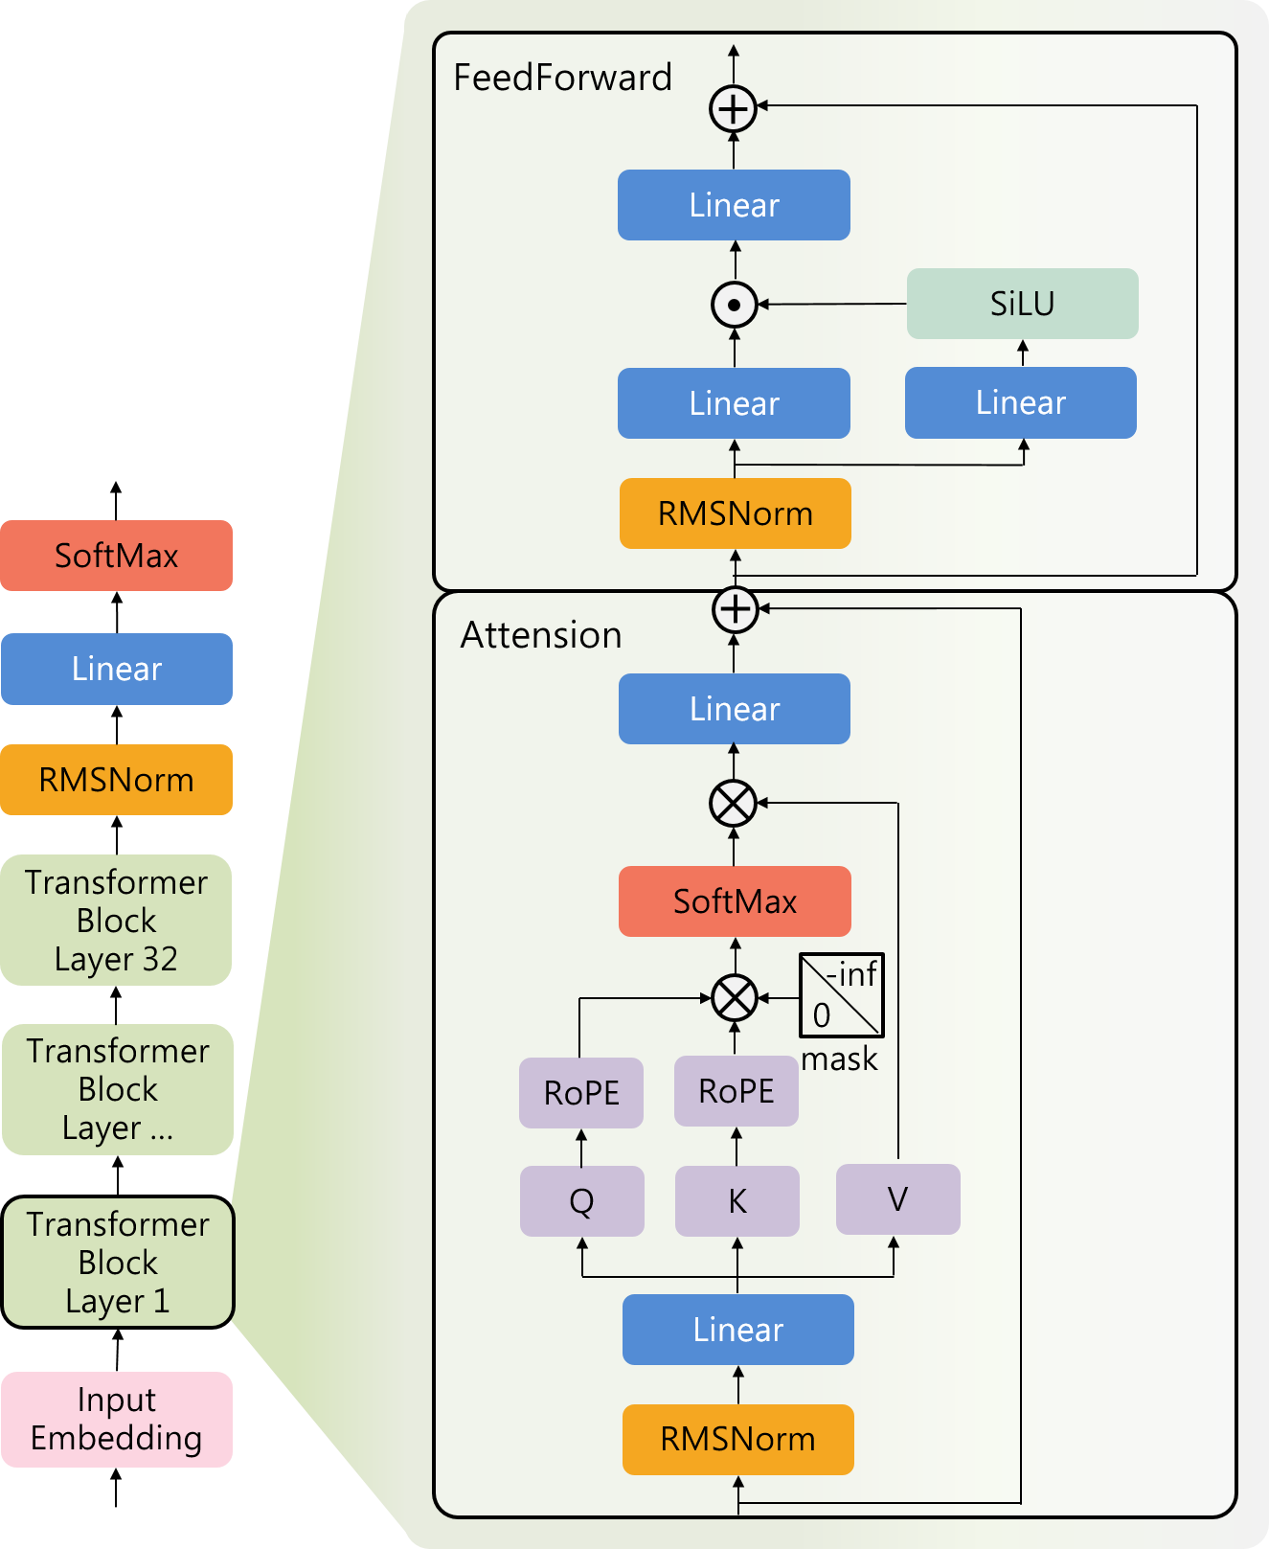
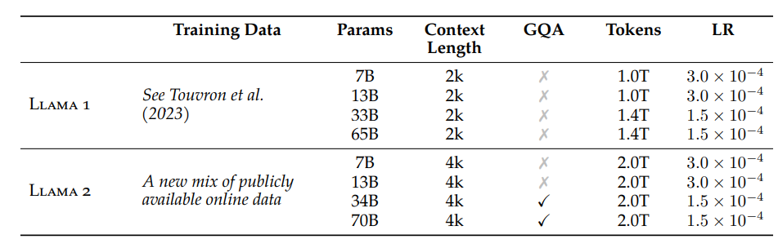
LLaMA2 (Large Language Model Meta AI)
Meta’s Open-Source Large Language Model (LLM)
Foundation Language Model
▲ Comparison table outlining the differences between LLaMA1 and LLaMA2 models [1]
Increased Training Data by 40%
Utilized Grouped-query attention (GQA) to accelerate inference
Implemented RLHF (reinforcement learning from human feedback) in Llama2-chat models to enhance model robustness.
▲ Architecture diagram of the LLaMA2 model
[1] H. Touvron et al., "Llama 2: Open foundation and fine-tuned chat models," arXiv preprint arXiv:2307.09288, 2023.
‹#›
Notes:
我們使用的是滿拓提供的LLaMA2模型，LLaMA是Meta開源的大型語言模型，我們這次是採用7個B參數的LLaMA來進行finetune
說明LLaMA裡面是由Transformer組成
而且Transformer又比RNN好
可以在長序列的任務中表現較好

Slide 20
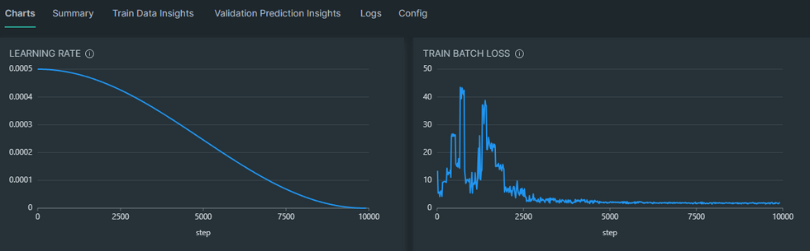
Fine-tuning : LLaMA2 to 3D Channel GPT
Input
Output
A question contains info.
Pretrained
LLaMA2
Tx location
Rx location
Tx<->Rx distance
Frequency
LOS flag
Signal quality opinion
99% Data is used for Finetuning
1% Data is allocated for Validation
Vertical (Y-axis): Training loss
Horizontal (X-axis): Training steps
▲ Training Loss Convergence Curve for the Model
‹#›
Notes:
這邊簡單說明一下我們是怎麼把ＬＬＡＭＡ２ finetune成3D channel gpt
我們把剛才提到的通訊資料集的Question作為模型的input，Answer作為output
然後把99%的資料用做finetune，以及1%的資料用做validation
Finetune的過程可以看到像右下這張圖，這張圖是滿拓的finetune exper的介面，從這邊就可以看到我們的training loss的收斂狀況
最後訓練完後就是3D channel GPT了
列一下XY單位
列一下LOSS FUNCTION\
放上硬體資訊

Slide 21
Model Validation
‹#›
Notes:
接下來是我們3D channel GPT的驗證結果

Slide 22
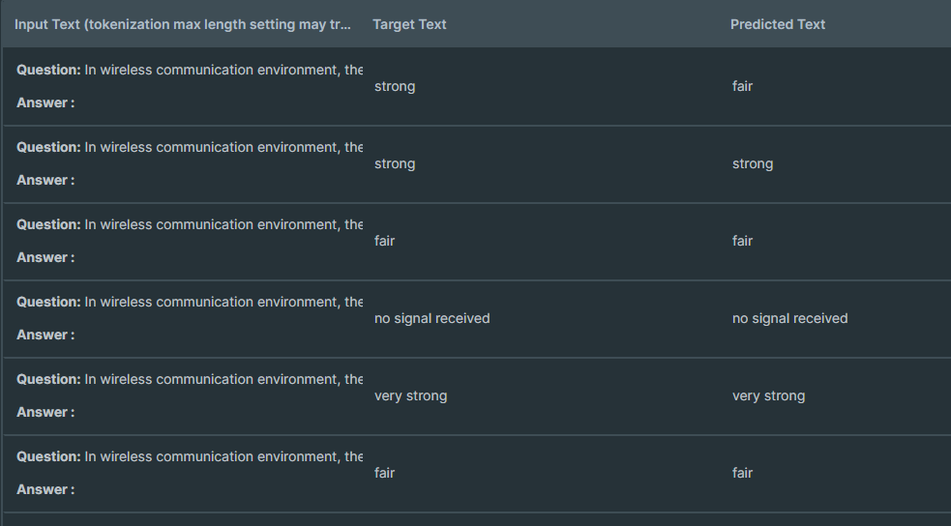
Case 1 : Single Base Station Scenario
generate
input
output
3D Channel GPT
……, what is the received power level?
Very strong
Randomly selecting 100 data points yields an accuracy of 84%
"Evaluating the effectiveness of LLM model in wireless communication scenarios."
▲ Comparison of the actual results and model output
‹#›
Notes:
首先是針對第一個case說明，我們模型的輸入資料就是基地台還有用戶的位置資訊還有通訊參數的設定，最後則是在input的question中詢問通訊品質。
3D channel GPT在計算後就會回答像是very strong之類的結果
最後我們採樣了100筆資料，準確度高達84%，初步驗證了大型語言模型在無線通訊場景的有效性
右下是滿拓的deep exper的介面，因為看起來有點小所以我來幫大家放大一下

Slide 23
Case 1 : Single Base Station Scenario
Result Comparison : Model Prediction vs. Actual Results
User Location
(-226,365,1)
(232,-146,1)
(-594,-215,1)
(-213,-351,1)
(-17,67,1)
(-559,-317,1)
Fail
Correct
Correct
Correct
Correct
Correct
‹#›
Notes:
在這個界面中，左邊是我們問模型的問題，紅色的部分是正確答案，橘色的部分則是模型回答的答案，
從這邊可以看出3D Channel GPT的精準確實是還不錯的

Slide 24
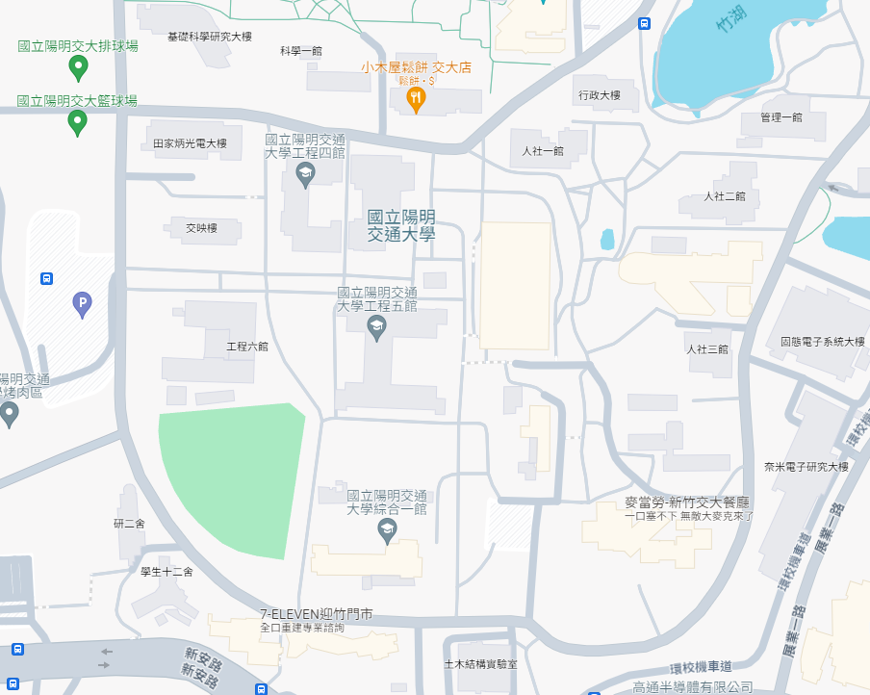
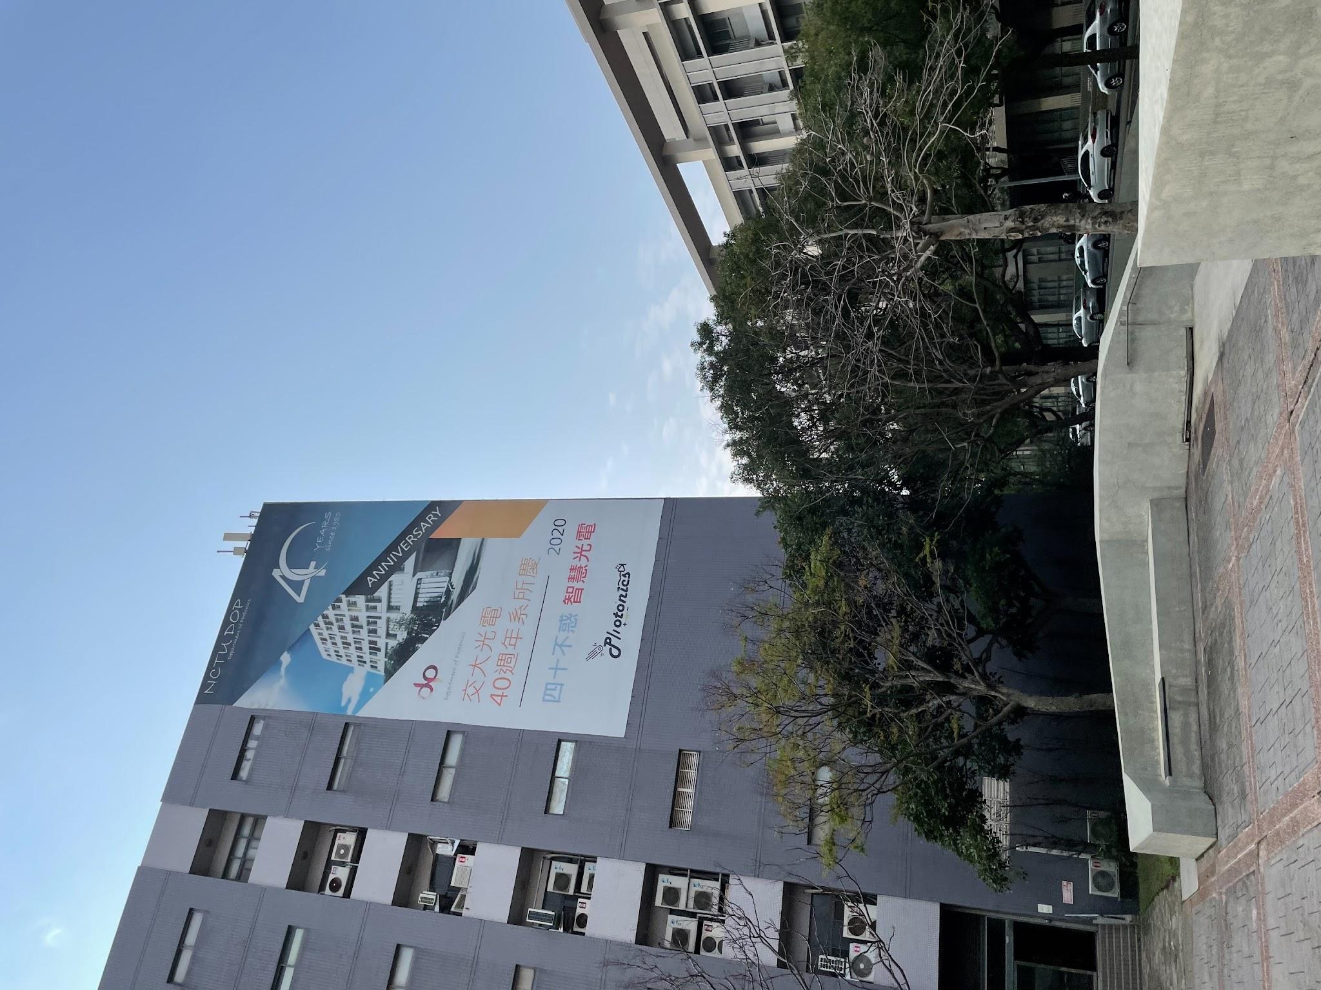



Case 2 : CHT BSs Signal Quality Opinion by 3D Channel GPT
Objective: Estimating signal quality with multiple base stations in the campus environment of NYCU Campus
Expected Results
(Q&A Format 1)
……, which base station's signal is the strongest?
Record
User Location
base station B
BSs (A/B/C) Location
User - BSs Distance
(Q&A Format 2)
…… Please answer the received power level of all base stations.
Signal Quality of User Specific Location from BSs
base station A : no signal received
base station B : strong
base station C : very weak
▲ Actual deployed locations of Chunghwa Telecom base stations in the Guangfu Campus of Yang Ming Chiao Tung University
‹#›
Notes:
接下來是我們的Case2 相較於Case1是模擬一個基地台的通訊，case2則是參考了真實環境，模擬了在交大裡面的複數個基地台的通訊環境，
從左邊那張圖可以看到三個不同的基地台，這幾個都是我們在校園內實際看得到的中華電信的基地台。（業配？）
我們在這個case的目標就是在多個基地台的環境中來預測訊號品質。從這個case裡面我們把Q&A變成了兩種形式，
一種是問你哪個基地台的訊號最強，另外一種則是直接詢問你在這個位置上所有基地台的訊號品質

Slide 25
Case 2 : CHT BSs Signal Quality Opinion by 3D Channel GPT
Wireless communication parameter setting
Parameters | Description
BS A Position | (-150, -330, 40)
BS B Position | (0, -275, 40)
BS C Position | (-150, 50, 40)
Carrier Frequency | 2.65 GHz (4GLTE band 7)
User Position | Random
Best signal quality among BSs?
Signal quality opinions?
Input
Output
A question contains info.
Pretrained
3D Channel GPT
BS A/B/C location
User location
Frequency
LOS flag
BS with max received power
Signal quality opinions of all BSs
99%Training 1%Validation
(Format 1 10,000 data)
(Format 2 10,000 data)
Randomly sample 10,000 data
Conversion to 20,000 Q&A format
‹#›
Notes:
至於我們是怎麼finetune的呢
我們和case1一樣取樣了10000筆資料，但因為我們在case2有兩種問題，所以我們再把那些資料分別轉換成兩種形式，讓資料總共有20000筆。
並使用case1訓練好的pretrained 3D channel GPT來去做finetune

Slide 26
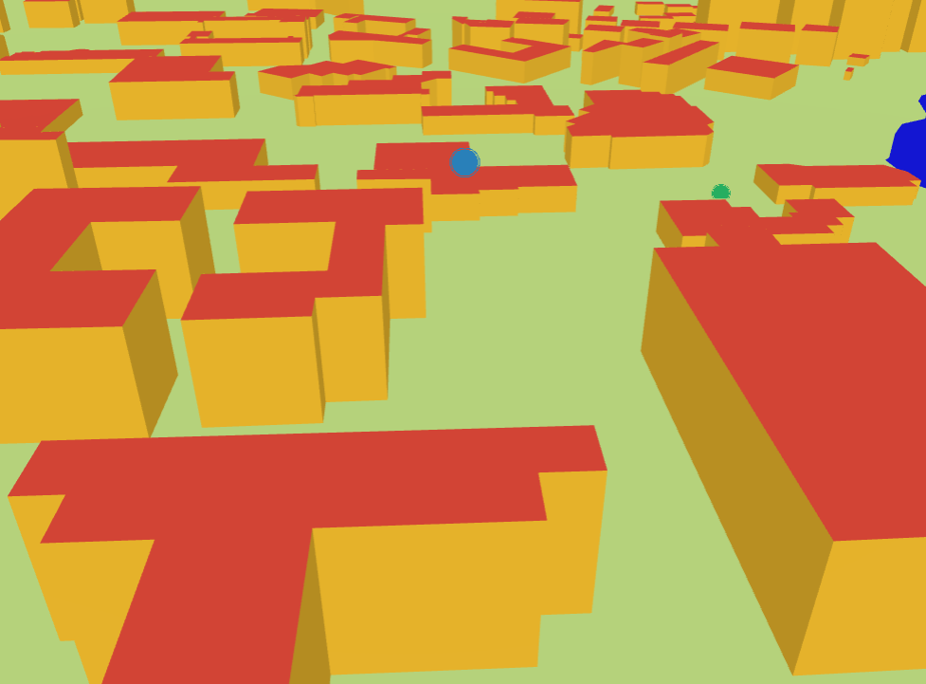
Case 2 : CHT BSs Signal Quality Opinion by 3D Channel GPT
generate
Q1
input
output
A1
……, which base station's signal is the strongest?
base station B
3D Channel GPT
Q2
A2
…… Please answer the received power level of all base stations.
base station A : no signal received
base station B : strong
base station C : very weak
(Q&A Format 1)Randomly sample 100 data, resulting in an accuracy of 67%
(Q&A Format 2)Randomly sample 100 data, resulting in an accuracy of 62%
(Due to the increased complexity of the scenario, the accuracy has decreased compared to Case 1.)
Furtherly extend the capabilities of 3D Channel-GPT model through users and Multiple base stations through simple Q&A interactions
‹#›
Notes:
接下來我來說明一下訓練的結果。我們的模型在使用的時候，question的部分前半段都是一樣的，
主要的差別在最後一句的問題是要問你哪個基地台的訊號品質最好，還是請你把所有基地台的訊號品質都列出來
雖然因為環境變得比較複雜所以準確度相較於case1有所下降，不過從這邊可以知道3D Channel GPT模型的功能是能夠再拓展的，讓用戶能夠透過簡單的問答方式獲取各基地台資訊，可以用做未來選擇基地台連結的參考

Slide 27
Conclusions
We(NYCU ICCLab) creates 3D Channel GPT (Generative Pretrained Transformer), achieving signal quality opinion score up to 84% accuracy with the help of DeepMentor solution.
Develop a methodology to generate the first open data radio signal map @ NYCU campus, which can be extended further for 3D+Radio dataset in other cities.
3D Channel GPT provides user-friendly Q&A dialogue service for assessing signal quality in site-specific 3D air-to-ground communication.
3D Channel GPT © 2024
‹#›
Notes:
最後再跟大家分享一下我們在這次GenAI的成果以及結論，希望大家可以有所收穫。
首先是我們使用滿拓的solution，透過對大型語言模型進行finetune，在訊號品質估測的任務上能夠達到80多%的精準度。
還有就是我們整合了開源的地圖資料以及通訊軟體，讓我們除了交大的通訊環境以外，像是隔壁的清大或是新竹市區都可以用我們的方法來去模擬。
最後則是我們的3D Channel GPT 可以提供user friendly的Q&A介面，讓沒有domain knowledge的人可以輕鬆知道特定區域的通訊狀況。

Slide 28
However underlying Challenges exists….
Stochastic vs Deterministic Models: While supporting 3GPP 38.901 channels, Sionna's accuracy in NLOS scenarios still trails specialized tools like Wireless InSite by 15-20% in beam selection tests
Quantization Effects: Hardware implementation mismatches emerge from ideal simulations vs actual RF impairments
Mobility Handling: Simulating high-velocity scenarios (e.g., >500 km/h) strains current ray tracing capabilities

Slide 29
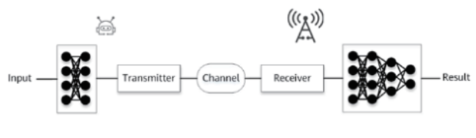

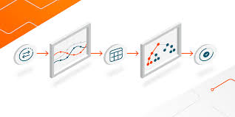
Learning Curve
Cross-Disciplinary Expertise Requires simultaneous mastery of:
TensorFlow/Keras for neural network integration
Communication theory (LDPC, MIMO, OFDM)
Ray optics for propagation modeling
source : beyond traditional communications, Huawei Research

Slide 30
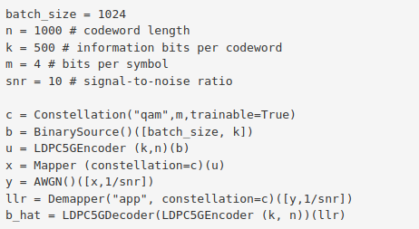
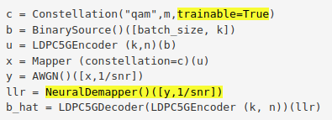
Learning Curve
2. API Complexity
The framework's flexibility introduces challenges in:
Debugging gradient flows through hybrid AI/DSP pipelines
Customizing lower PHY components while maintaining differentiability
Customization : replacing Demapper with NeuralDemapper

Slide 31
Operational Constraints
Version Compatibility: Strict requirements for Python 3.8-3.12 and TensorFlow 2.14-2.19 create dependency conflicts
Multi-GPU Scaling: Distributed training needs careful resource management for large batch sizes
Reproducibility: Differences in GPU architectures (Ampere vs Hopper) affect benchmark consistency

Slide 32
6G Physical-Layer Research Tools NVIDIA Sionna: An Open-Source Library
Presenter：Chia-Chuan Chiu
Advisor：Li-Chun Wang
Class GitHub: https://github.com/NYCU-ICCLab/sionna_introduction
NVIDIA website: https://developer.nvidia.com/sionna
Sionna official tutorial: https://nvlabs.github.io/sionna/index.html
Sionna GitHub: https://github.com/NVlabs/sionna

Slide 33
Key Features of Sionna
Modular & Flexible Design
Modular architecture that can be easily customized or extended.
Allows quick prototyping of complex communication systems.
Integration with Deep Learning
Parameters are constructed using TensorFlow
High Computational Efficiency
Accelerated by GPU computing

Slide 34
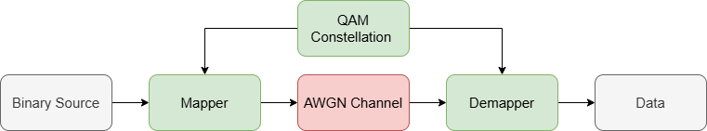
Key Features of Sionna
Modular & Flexible Design
Modular architecture that can be easily customized or extended.
Allows quick prototyping of complex communication systems.
Integration with Deep Learning
Parameters are constructed using TensorFlow
High Computational Efficiency
Accelerated by GPU computing

Slide 35
Key Features of Sionna
Modular & Flexible Design
Modular architecture that can be easily customized or extended.
Allows quick prototyping of complex communication systems.
Integration with Machine Learning
Parameters are constructed using TensorFlow
Users can easily implement machine learning models.
High Computational Efficiency
Accelerated by GPU computing

Slide 36
Key Features of Sionna
Modular & Flexible Design
Modular architecture that can be easily customized or extended.
Allows quick prototyping of complex communication systems.
Integration with Machine Learning
Parameters are constructed using TensorFlow
Users can easily implement machine learning models.
High Computational Efficiency
Accelerated by GPU computing
Change to AI model
AI model

Slide 37
Key Features of Sionna
Modular & Flexible Design
Modular architecture that can be easily customized or extended.
Allows quick prototyping of complex communication systems.
Integration with Machine Learning
Parameters are constructed using TensorFlow
Users can easily implement machine learning models.
High Computational Efficiency
Accelerated by GPU computing

Slide 38
Basic Usage of Sionna

Slide 39
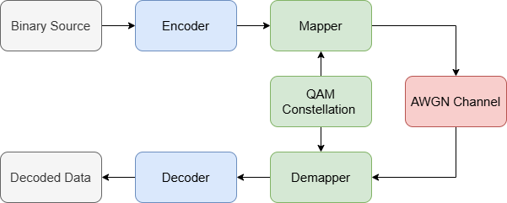
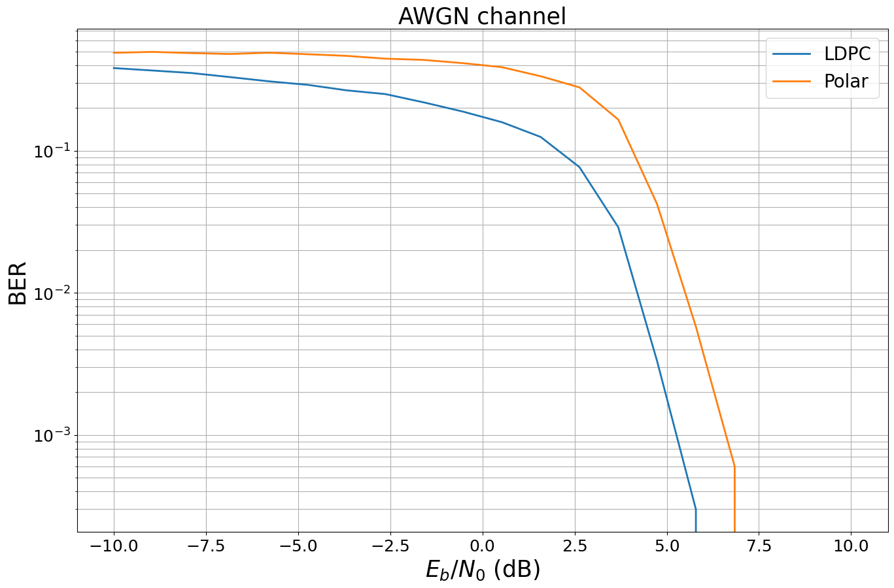
Case 1 : System Performance Evaluation
Channel coding comparison: LDPC vs Polar

Slide 40
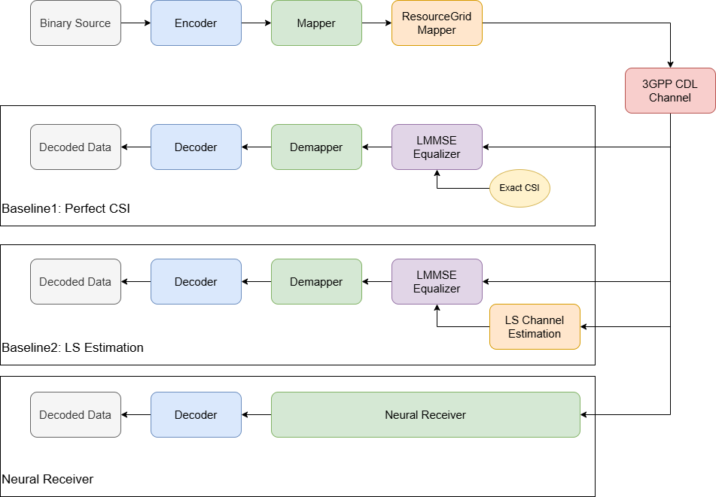
Case 2 : Neural Receiver

Slide 41
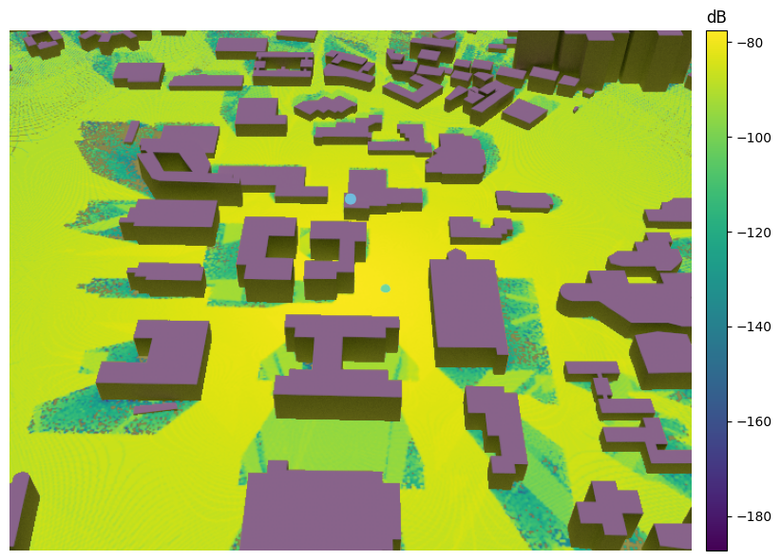
Case 3 : Ray Tracing
Ray tracing simulation in NYCU campus

Slide 42
Thank You
Class GitHub: https://github.com/s87315teve/sionna_introduction
NVIDIA website: https://developer.nvidia.com/sionna
Sionna official tutorial: https://nvlabs.github.io/sionna/index.html
Sionna GitHub: https://github.com/NVlabs/sionna

